Slide 1
LIFE INSURANCE MARKET OF PAKISTAN

Slide 2
Life Insurance Market
There are nine life insurers, including two family takaful operators, and one state-owned insurer in the life insurance sector, namely:
State Life
Jubilee Life
EFU Life
IGI Life
Adamjee Life
TPL Life
East West Life
Pak Qatar Family Takaful
Dawood Family Takaful
Gross written premium of Life Insurance industry in year 2017 was PKR 209 billion.
Conventional life insurers are also allowed to write Family Takaful business through their Window Takaful Operations after approval from the regulator

Slide 3
Regulator
The SECP is the apex regulator of the insurance sector in Pakistan and aims to:
regulate the insurance sector in line with best international regulatory practices;
develop the insurance industry into mature market, which can meet the financial protection needs of all societal segments in Pakistan.

Slide 4
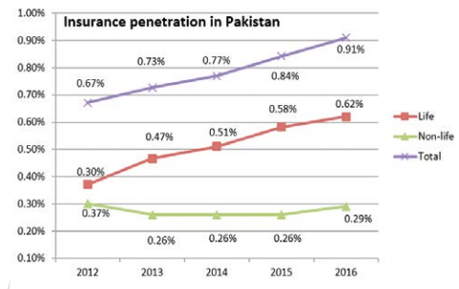
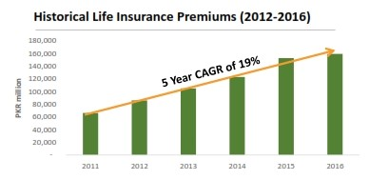
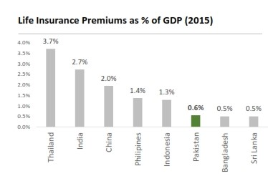
Growth and Insurance Penetration
Insurance penetration as a percentage of GDP is increasing, however it is still lower than regional average. This shows that potential of growth is high.

